Slide 1
Presentation on
AKSHAR
at
AMITY UNIVERSITY RAJASTHAN, JAIPUR (INDIA)
For partial fulfillment of the degree
of
Bachelor of Technology
in
Computer Science and Engineering
Under the Guidance of
Dr. Rekha Chaturvedi
Asiistant Professor (CSE)
By
Konagandla Bhaskar A20405217088
Kartik Sharma A20405217121
P Venkata Hemanth A20405217065
12th June 2021

Slide 2
Content
Abstract
Introduction
System Configuration and Software Used
Methodology
Results
Discussion
Conclusion
Future Scope
References
Acknowledgement

Slide 3
Abstract
There are lot of actions that we do on data that takes much time and consume more human resources.
Natural Language Processing allow computers to track, extract, and analyse the vast array of information.
This application is an one stop solution for most of the text related tasks that we encounter daily on our large corpus of data which include large articles , text documents etc.
It manages user given data and aids users to grasp much information and get valuable insights of their data.
The application provides textual summary of input in both extractive and abstractive ways.
Sentence ranking is used for giving scores and extracting senteces for extractive summaries.
Tf - idf method is used for getting keywords.
web scraping is used for getting text from internet during the extraction of summaries or for the sake of getting answers to the users questions.
Also, the application generates visualizations of your textual data ( through word cloud representations , statistics of different kinds of words ) , keywords extraction etc. for gaining better knowledge.
Users can also query their own text for answers or just give an question to the application which can try to fetch relevant answers.

Slide 4
Introduction
Problem Definition
This project is based on shrinking the text to the extent that is useful for the user. The aim is to generate summaries by keeping sentence relativity , meaning and mainly important and required information form the original text , also to request answers to the questions generated by users , to make some visuals out of text that will help more for us to get into it.
Objectives
✓The model must summarize the given corpus of text ( of any length).
✓Help visualizing the text for the user.
✓Keywords extraction.
✓Give short information upon user’s search query.
✓In document Query resolution.
Reading out the text and higllighting the keywords in the text.

Slide 5
System Configuration and Software Used
Software Requirements
System Configuration
HTML
CSS
JAVA SCRIPT
PYTHON
Flask
System : Any processor after Pentium
Hard Disk : 40GB
Monitor : 14’ColourMonitor
Mouse : Optical Mouse
Ram : 2 GB

Slide 6


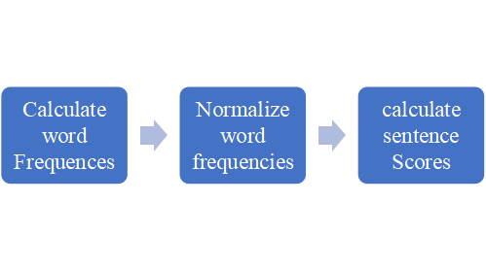
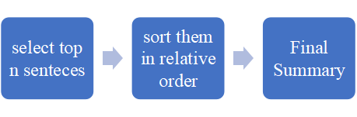
Methodology
Extractive Text
Summarization

Slide 7
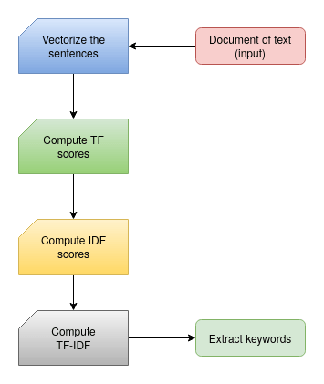
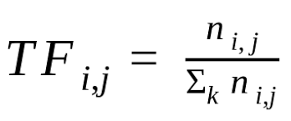
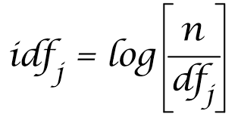
Methodology
Keywords Generation
TERM FREQUENCY(TF)
INVERSE DOCUMENT FREQUENCY(IDF)

Slide 8


Methodology
Information Retrieval
Extractive
answering
Specific
Internet
Akshar
Extractive
Summary
Internet
Generic

Slide 9
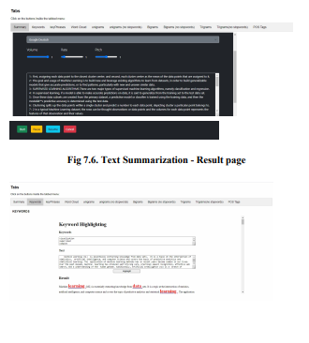
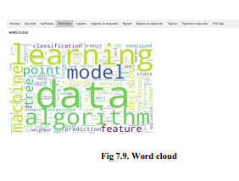
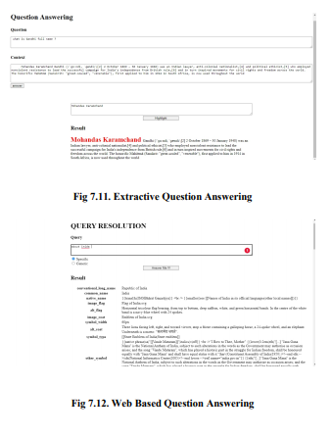
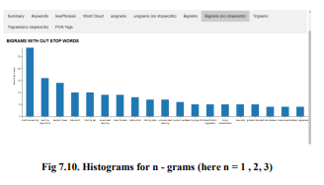
Results

Slide 10
Conclusion
Automatic Text Summarizers performs an important role by providing a summary of a whole text document by extracting only the useful information and sentences.
As the availability of data in the form of text increasing day by day. It becomes so difficult to read the whole textual data in order to find the required information which is both difficult as well as a time-consuming task for a human being.
The real-world applications of text summarization can be: documents summarization, news and articles summarization, review systems, recommendation systems, social media monitoring, survey responses systems.
Also , the IR systems give better and crisp answers without being flodded by the loads of data in the internet.
Humans grasp and retain much information from visual images .
Akshar can help with reducing the mundane tasks that we encounter regularly and saves a lot of time and makes getting information from textual data fun.

Slide 11
Future Scope
The future goals of this project is to reduce the inefficiencies in the summaries by enhancing the the techniques used for overcoming the challenges as stated, by employing more effective methods.
Make much more useful visualizations for the gaining the best out of the context.
Better the techniques used for scraping the web during text extraction form internet.
create multi-document summarizations.
The ultimate aim is fine tune every aspect of the project and make overall performance as close as possible to humans

Slide 12
References

Slide 13
Acknowledgements

